Slide 1

Differentials Applied Example 1
RCET 0264 Introductory Calculus
Tim Leishman

Slide 2
differentials
The side of a square measures 12.00 cm with a maximum possible error of 0.05 cm. (a) Find the maximum possible error in the area using differentials. (b) Find the maximum possible error by substituting into the formula for the area of a square. (c) Find the percentage of error.

Slide 3
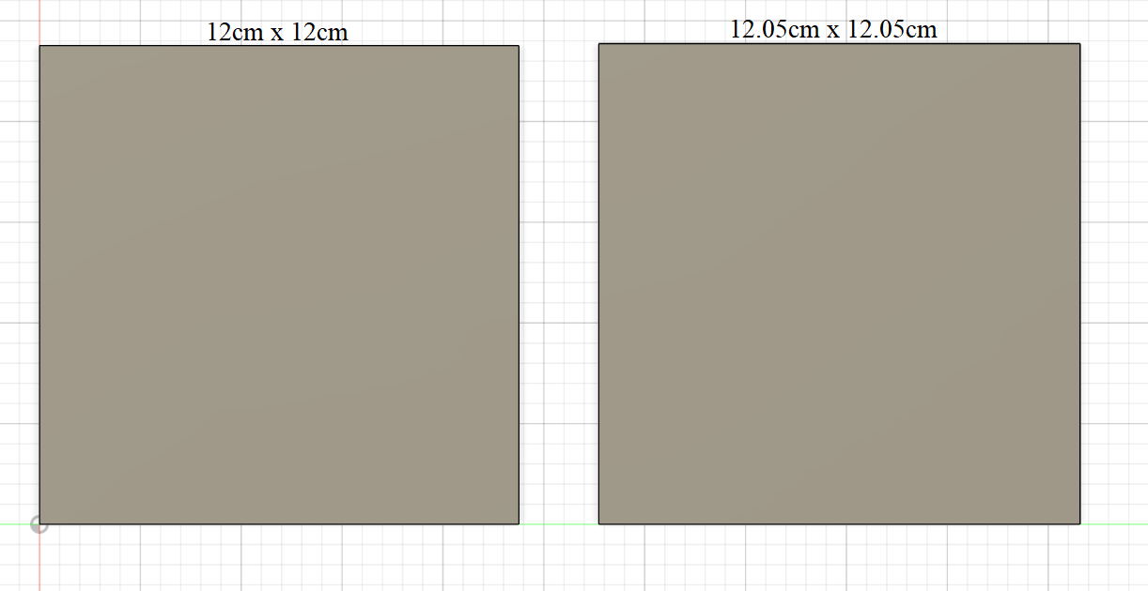
differentials
The side of a square measures 12.00 cm with a maximum possible error of 0.05 cm. (a) Find the maximum possible error in the area using differentials. (b) Find the maximum possible error by substituting into the formula for the area of a square. (c) Find the percentage of error.

Slide 4

differentials
The side of a square measures 12.00 cm with a maximum possible error of 0.05 cm. (a) Find the maximum possible error in the area using differentials. (b) Find the maximum possible error by substituting into the formula for the area of a square. (c) Find the percentage of error.
Find the maximum possible error in the area using differentials.
Side = 12.00cm to 12.05cm
Area = Side x Side
$Area = S^{2}$
$\frac{da}{ds}=2S$
$da=2S\left(ds\right)$
$da=2(12)(0.05)$
(a) $da=1.2 {cm}^{2}$

Slide 5

differentials
The side of a square measures 12.00 cm with a maximum possible error of 0.05 cm. (a) Find the maximum possible error in the area using differentials. (b) Find the maximum possible error by substituting into the formula for the area of a square. (c) Find the percentage of error.
Find the maximum possible error by substituting into the formula for the area of a square.
Side = 12.00cm to 12.05cm
Area = Side x Side
$Area = S^{2}$
$Area1 = {12}^{2}$
$Area1 =144{cm}^{2}$
$Area2 = {12.05}^{2}$
$Area2 = {145.203cm}^{2}$
$\max{error}={145.203cm}^{2}−144{cm}^{2}$
(b) $\max{error}=1.2025{cm}^{2}$

Slide 6

differentials
The side of a square measures 12.00 cm with a maximum possible error of 0.05 cm. (a) Find the maximum possible error in the area using differentials. (b) Find the maximum possible error by substituting into the formula for the area of a square. (c) Find the percentage of error.
Find the percentage of error.
Side = 12.00cm to 12.05cm
Area = Side x Side
$Area = S^{2}$
$Area = {12}^{2}$
$Area = {144cm}^{2}$
$da=1.2 {cm}^{2}$
$Area error= \frac{da}{Area}=\frac{1.2 {cm}^{2}}{{144cm}^{2}}=0.008333 OR\frac{1.2025 {cm}^{2}}{{144cm}^{2}}= .00835069$
Area $\%error=0.833\% OR 0.835\%$

Slide 7
Maximum & Minimum
References:
Ewen, D., Gary, J. S., & Trefzger, J. E. (2005). Technical calculus. Upper Saddle River, NJ: Pearson/Prentice Hall.
https://www.desmos.com
https://www.autodesk.com/products/fusion-360/overview

